Slide 1
Why Community?
Abigeal Adenigbabe
Enterprise Application Specialist

Slide 2
Lets discuss
Why does a community exist?
Why you need to be an active member
What are the benefits ?
How often do the community meet?
Connect with us
…More!

Slide 3
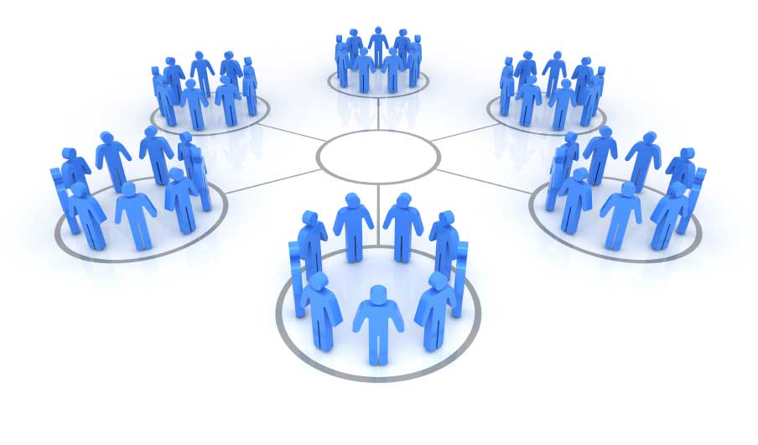
A community is a support system Group of people interacting to share a common understanding

Slide 4
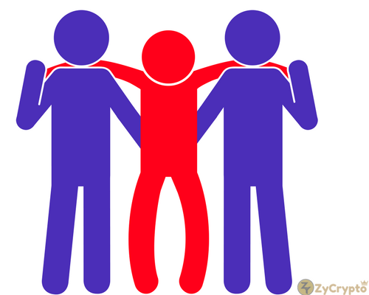
“We Need Each Other to Survive”
Career
Stay abreast of trends
Learn best practices
Feel among
Leveraging on Relationships
Achieve more

Slide 5

Being Active = Being Seen
Network with People
Collaborate
Job Opportunity
Leadership Skills
Volunteering Opportunity
Unavailable Information
Speaking engagement
Microsoft event and Travel opportunity
Life Partner Maybe.. LOL

Slide 6
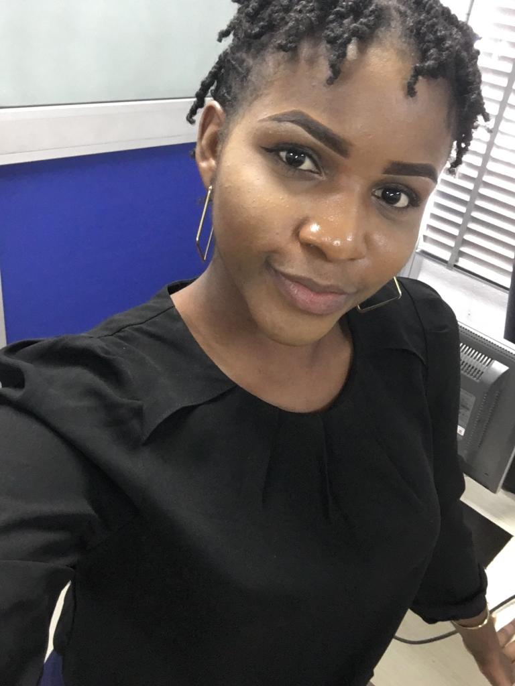
Meet the PowerAppsUsergroup9ja CCO
I wanted to network with people
Volunteer in my area of work
Make real impact
Enhance my skills

Slide 7

Meet ups – Virtually / Offline
Show and tell – Sundays 7pm
Questions and answers on MS Kaizala
BootCamp
Meetings and learn

Slide 8



Connect with the Community @Powerappsug9ja

Slide 9
Thank You

